Slide 1
ECO: Efficient Convolution Operators for Tracking
CS6680 - Agnibh Dasgupta (A02292865)
CS5680 – Jake Rosqvist (A01654526)

Slide 2
Introduction
Object Tracking: A challenging problem.
Target localization.
Tracking the move object at each timeframe through the length of the sequences.

Slide 3
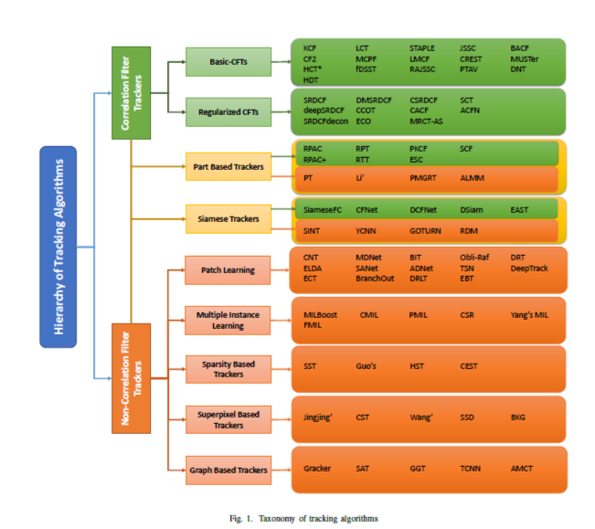
Current techniques

Slide 4
Proposed Approach
1. Factorized Convolutional Operator
2. Generative Sample Space
3. Sparse Model Update

Slide 5
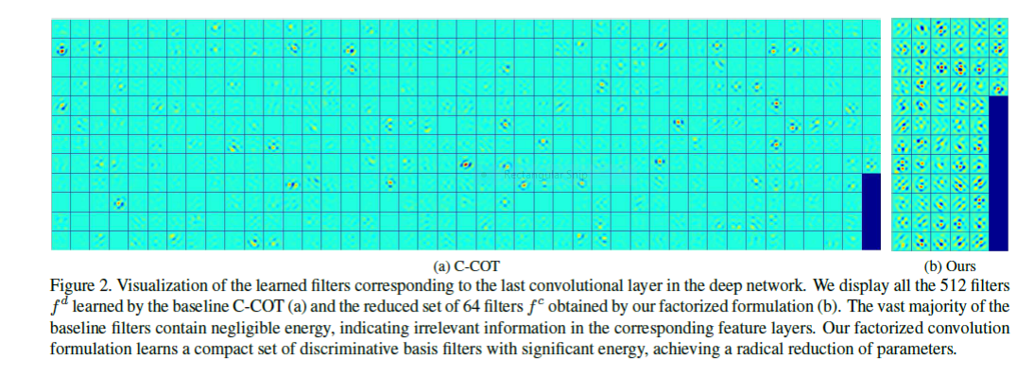
Factorized Convolutional Operator
To reduce the number of parameters in the model by eliminating regions of low energy to reduce redundant parameters when updating the network.

Slide 6
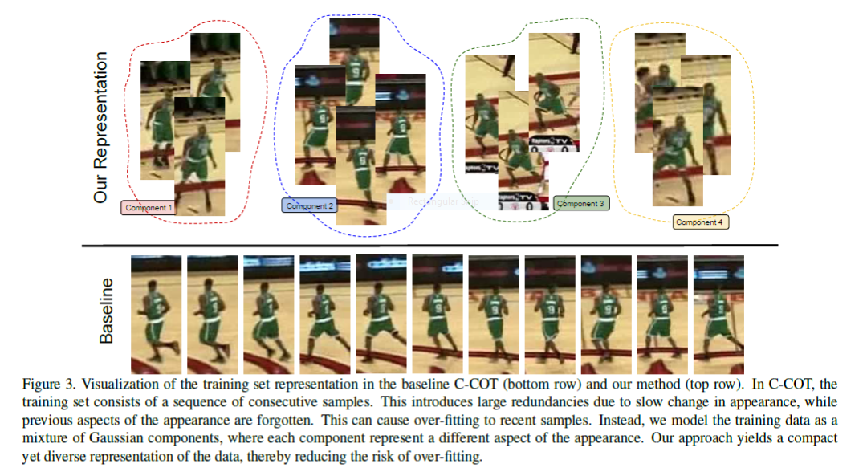
Generative Sample Space
To reduce memory and time complexity of the learning process, while maintaining sample diversity, by grouping together similar training data.

Slide 7
Sparse Model Update
Updates the model sparsely instead of at every single frame to reduce overfitting and computational complexity.
At every Nsth frame:
Updates the model
Performs Ncg conjugate gradient iterations to refine the model.

Slide 8
Shortcomings
Occlusion
Fast Motion
Noise

Slide 9
My Improvements
Added a variety of periodically distributed noise:
Salt and Pepper
White Gaussian (Variance = 0.01, 0.03, 0.05, 0.07, 0.09)
Applying noise removal techniques.
Training the CNN with cleaned images.
Tested and found filtered results to have better overlap ratio than noisy sequences.

Slide 10
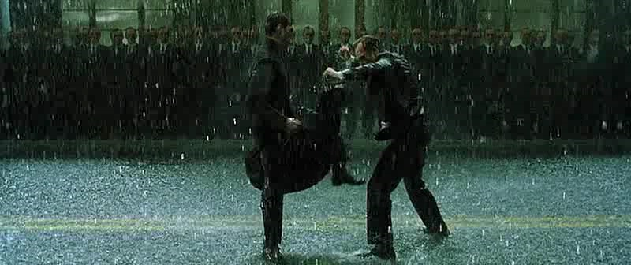
Noiseless: 0.2225

Slide 11
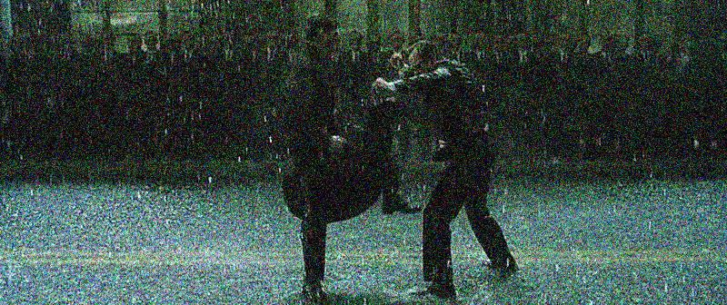
Presence of white Gaussian noise: 0.0543

Slide 12
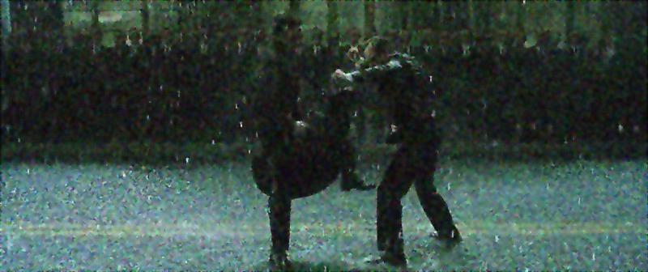
Presence of white Gaussian noise(Filtered): 0.1903

Slide 13
Experimental results
Sequences | ECO overlap ratio count | Noisy ECO overlap ratio count | Cleaned ECO overlap ratio count
Crossing | 0.8126 | 0.7824 | 0.7990
Skiing | 0.0488 | 0.0452 | 0.0487
Diving | 0.3082 | 0.2255 | 0.3569
MotorRolling | 0.0949 | 0.0716 | 0.0939
Matrix | 0.2225 | 0.0543 | 0.1903
Overlap ratio for 5 benchmark sequences

Slide 14
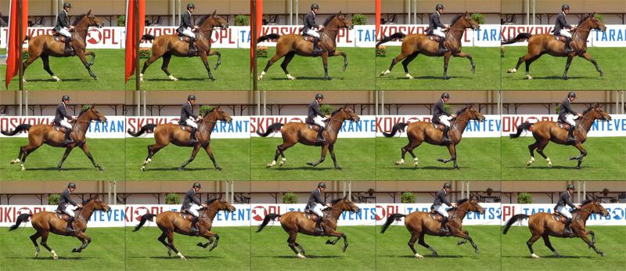
Frame Update Optimization
DCF algorithms update the model every frame
ECO reduces this to every 6 frames to improve speed
A frame update rate optimizer would further increase the speed

Slide 15
Conclusion
ECO suffers under presence of noise.
Preprocessing noisy images to clean them and training the CNN with them results in better tracking.

Slide 16
Future Work
Updating the model only when enough change in the model has occurred.
Ways to detect what kind of noise and filter accordingly.

